Slide 1

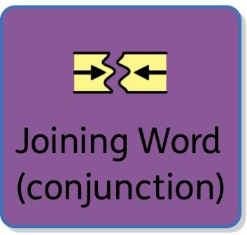




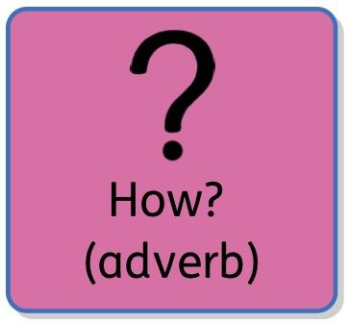


Slide 5
Simple Sentence - Year R and Year 1 (it is okay to swap where and what - movement verbs tend to use where)

Slide 6
Simple Sentence - Year R and Year 1 (using picture). Lots of oral rehearsal are they getting the little words; is and the?

Slide 7
1A Sentence - Year R and Year 1 (if it’s a travelling verb it normally goes to where)
The girl | drew | a red | door
The girl | sailed | to the huge | castle

Slide 8
‘ly Sentence’ - Year 2 - where or what to end, depending on the sentence
Excitedly | he | baked | a cake.

Slide 9
2A Sentence - Year 2
The bright, | radiant | sun | shone | onto the | beautiful, | green | grass.

Slide 10
BOYS Sentence - Year 2
I | like | fairtrade | because | it gives | me | more money | to spend.

Slide 11
List sentence - Year 2
It | was | a frightful, | frosty | and | freezing | day.

Slide 12
Verb Person Sentence
Running | Tom | almost | tripped over | his shoes.

Slide 13
Double ly sentence
She | sang | soulfully | and | mournfully.

Slide 14
‘If’ sentence (won’t particularly work but you can use the joining card to highlight all the 4 conjunctions.

Slide 15
Short Sentences - any card combination will work but by using just one or two cards you’re demonstrating that it’s short
Everything | stopped
Silence...
She | screamed!

Slide 16
4A Sentence - Year 4
Mr Twit | was | a dirty, | horrible | man, | with and | a long, | soggy | beard.

Slide 17
4A Sentence - Year 4
Mr Twit | was | a dirty, | horrible | man, | with and | a long, | soggy | beard.

Slide 18
4A Sentence - Year 4
Firstly, | I need | help | with my | awesome | birthday party | because

Slide 19
3-ed
Excited, | elated, | thrilled, | she | won | the dance competition

Slide 20
Emotion word, comma sentences

Slide 21
Personification of weather sentences - not sure if this one will work as CS but here is an example.
The rain | wept | down | the window

Slide 22
4A Sentence - Year 4
Mr Twit | was | a dirty, | horrible | man, | with | a long, | soggy | beard.

Slide 23
4A Sentence - Year 4
I | was | a young | funny | girl, | with | long, | brown | hair.

Slide 24
4A Sentence - Year 4
Ages ago, | I | studied | at | East Peckham Primary, | where | I | loved | reading.

Slide 25
-ing, -ed sentences
Walking | in the bush , | she | stopped | at the sight of the | blood thirsty | zombie.

Slide 26
-ing, -ed sentences
Walking | in the bush , | she | stopped | at the sight of the | blood thirsty | zombie

